Slide 1
Talent Management
Data Analytics
Employee Retainment & Salary Review

Slide 2
Initial Data Review
Minimal data cleaning required:
No NA’s
No erroneous data
A few columns that are unlikely to impact this analysis.
The columns are: Over18, EmployeeCnt, EmployeeNum, StandardHrs, Rand
Not included in this analysis

Slide 3
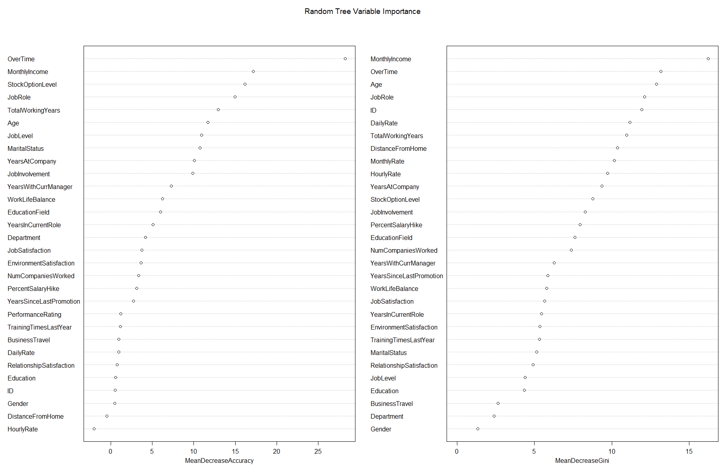

Slide 4
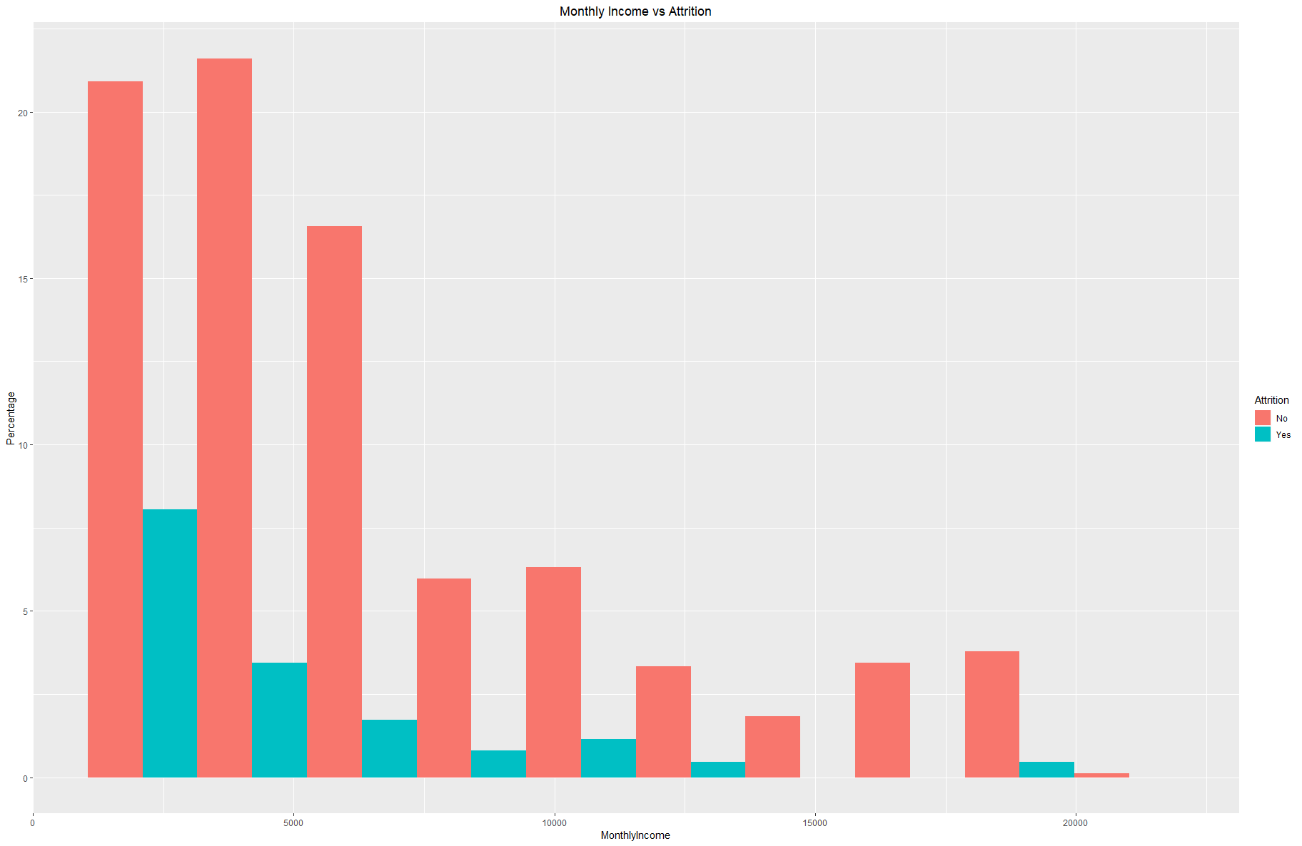
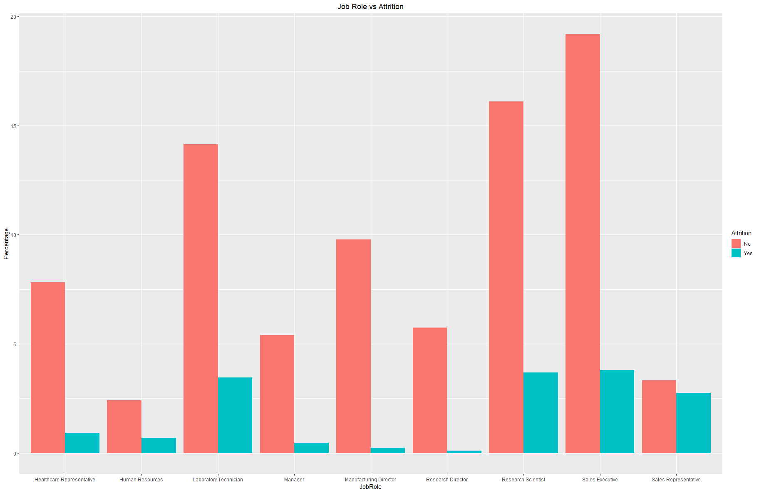
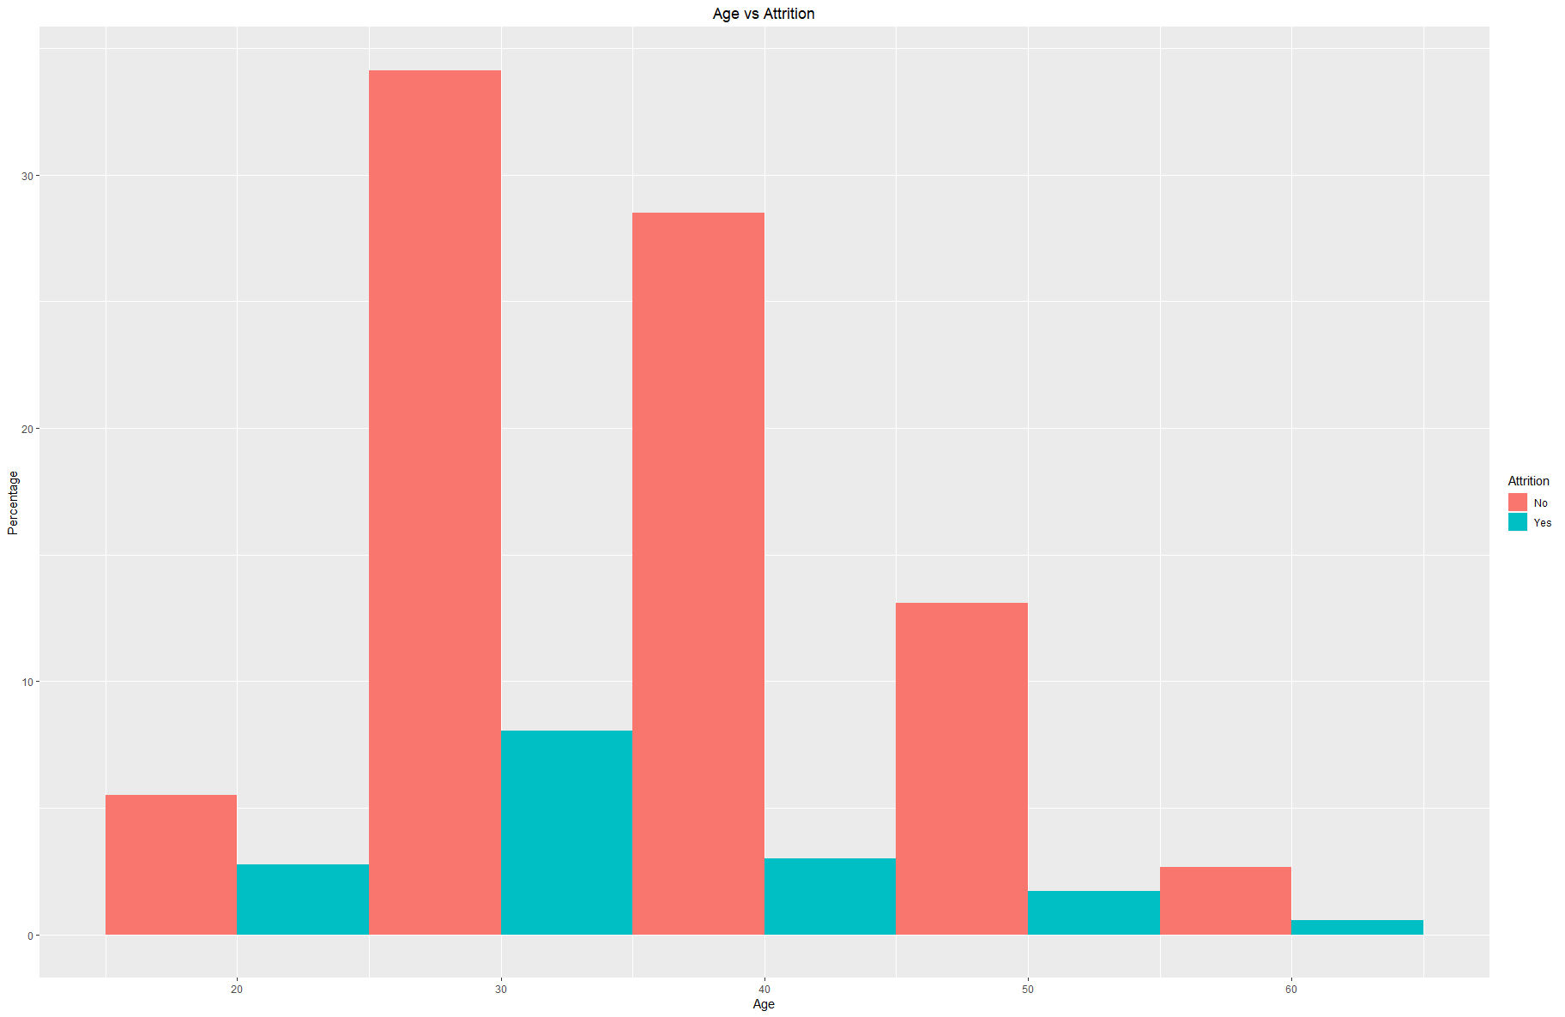
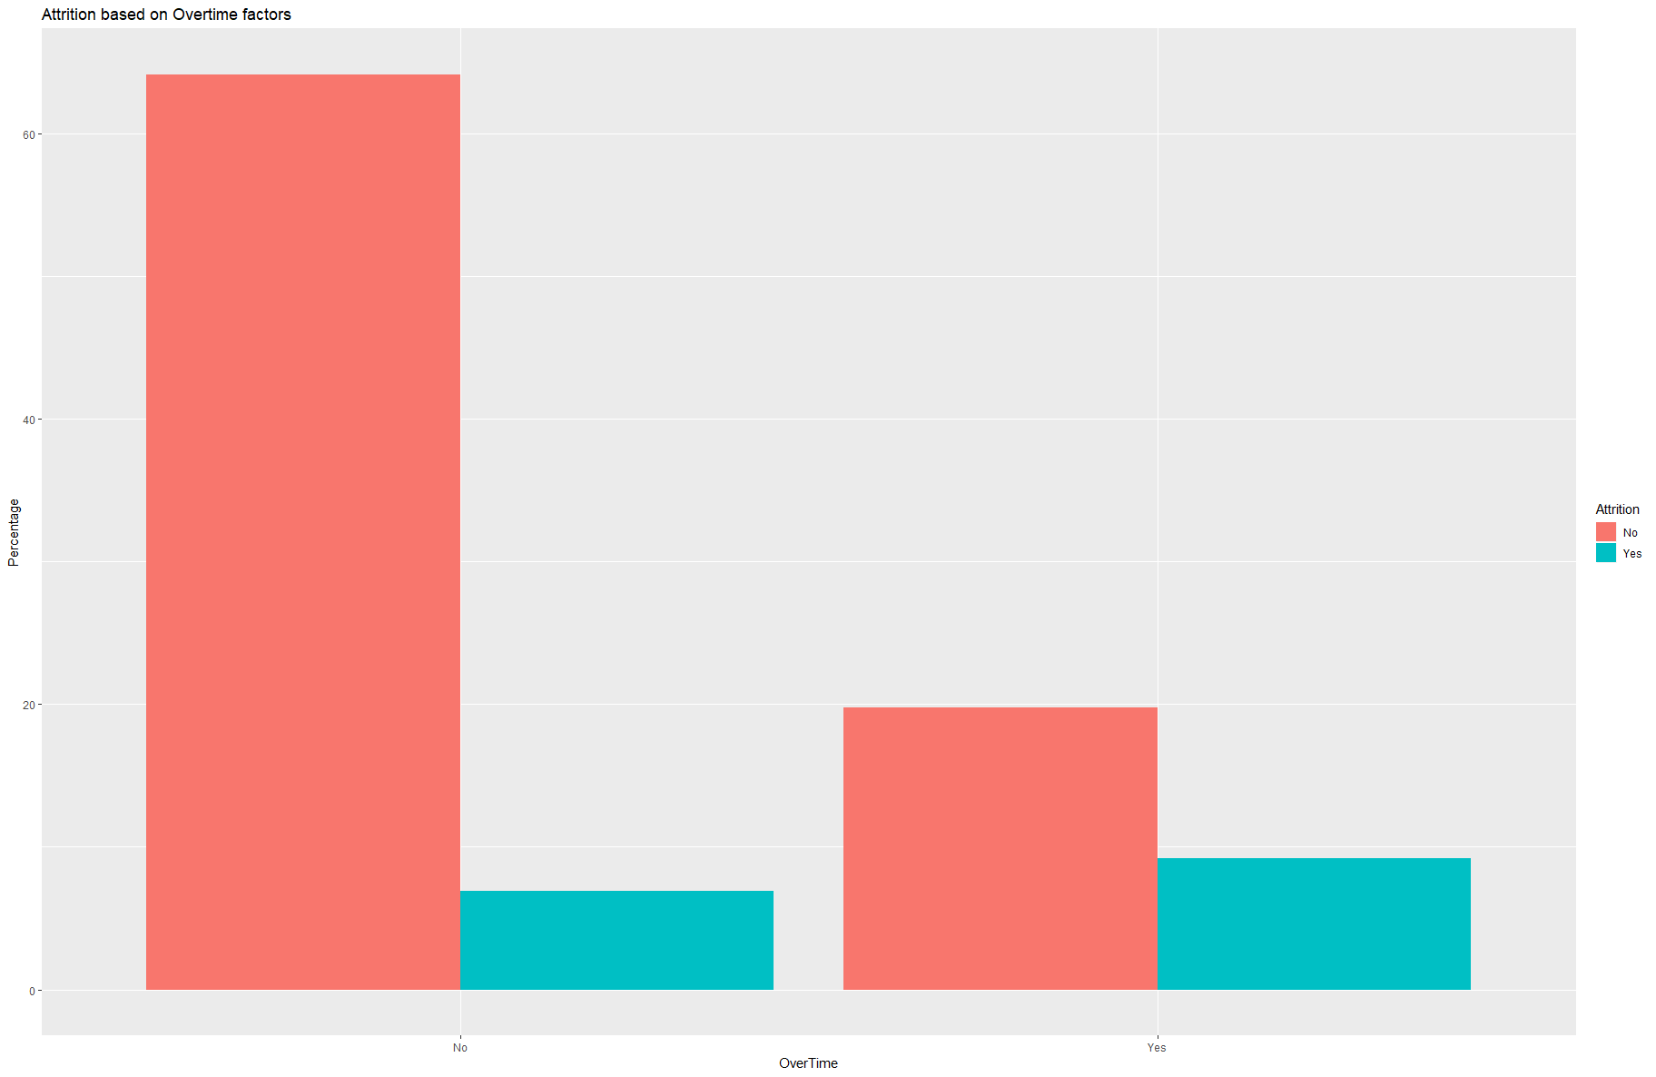

Slide 5
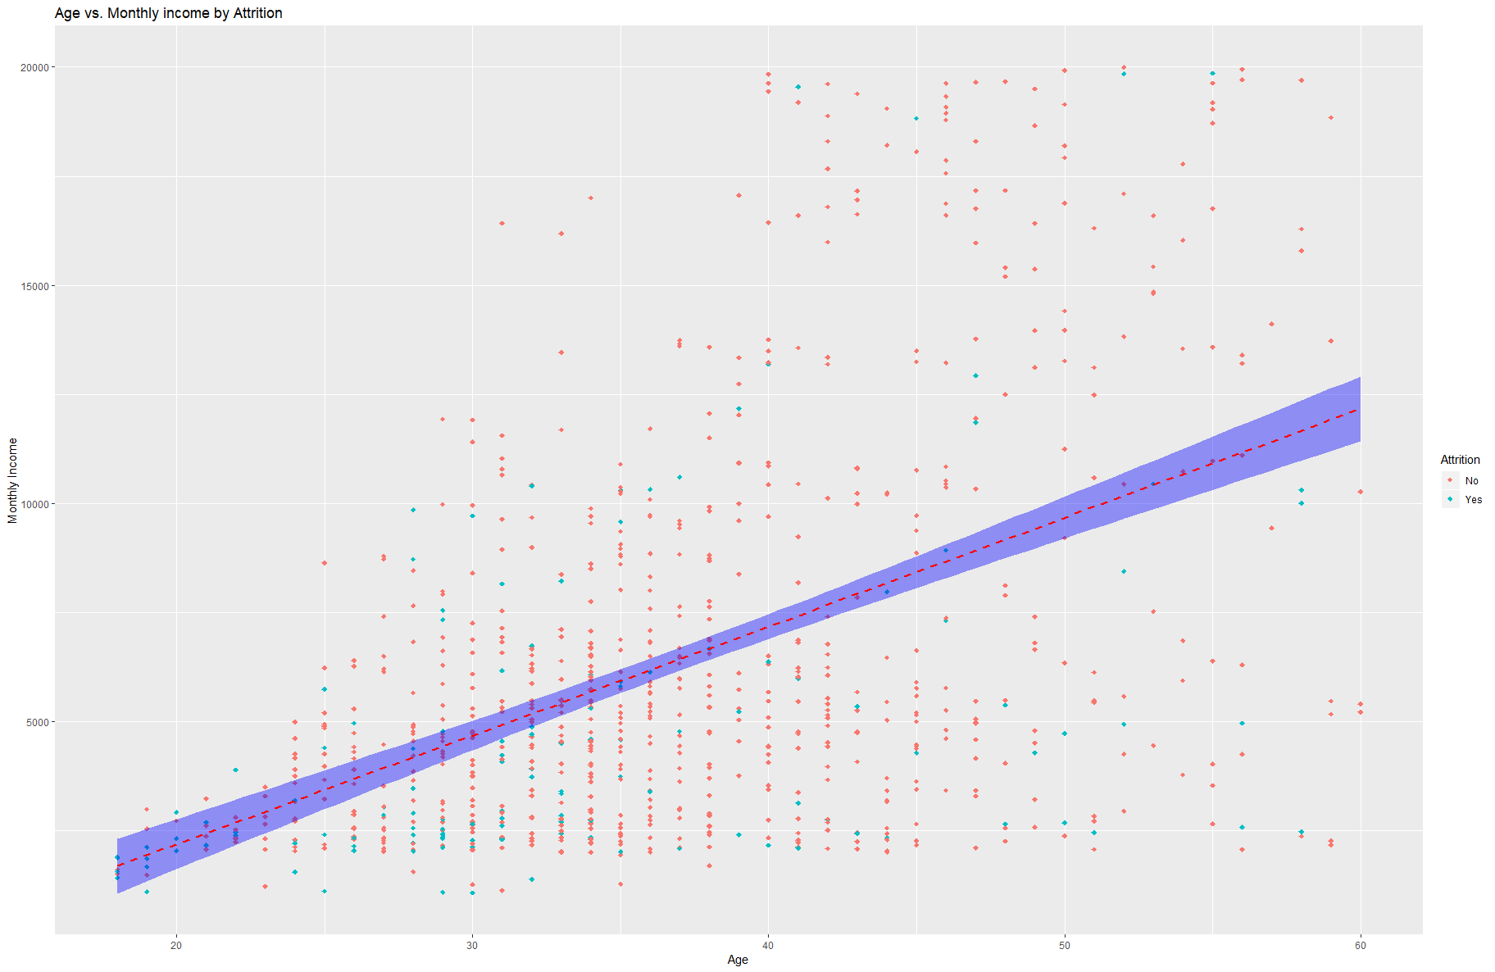

Slide 6
Percentage of additional groups experiencing Attrition
Gender | Percent
M | 14.97%
F | 16.86%
Job Involvement | Percent
1 | 46.81%
2 | 19.30%
3 | 13.04%
4 | 8.64%
Stock Options | Percent
0 | 25.86%
1 | 7.61%
2 | 3.70%
3 | 21.82%
Work Life Balance | Percent
1 | 35.42%
2 | 15.62%
3 | 15.04%
4 | 13.27%
Over Time | Percent
N | 9.71%
Y | 31.75%

Slide 7
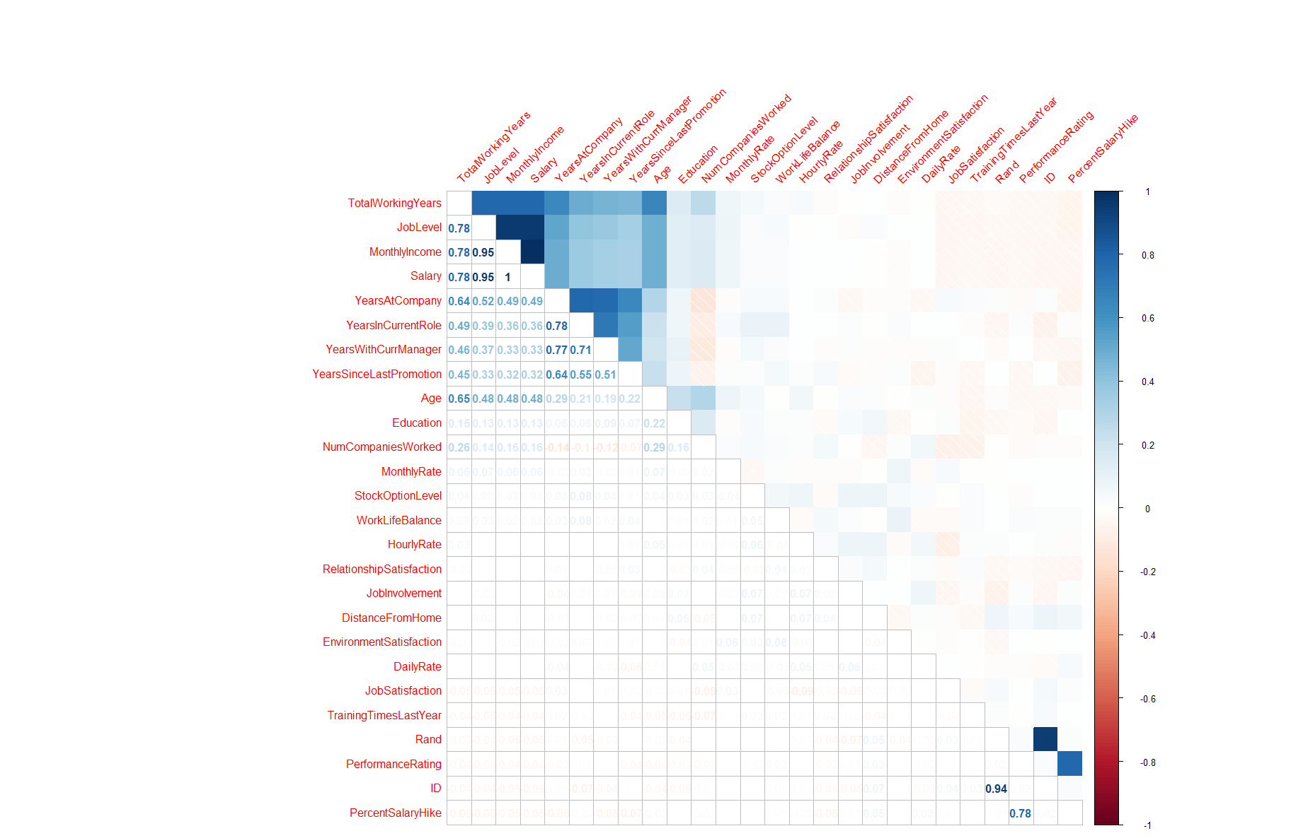

Slide 8
Important Predictors
The most important predictors are Over Time, Job Role and Monthly income
Other important predictors are factors such as Age and Marital Status
Based on these numbers one would conclude:
Young
Single
Low Income
Working long hours

Slide 9
Attrition Predictive Analysis
Assumptions:
Most variables had normal distributions
Sample size was robust enough to non normal distributions
All data collected is independent
Variance is equal

Slide 10
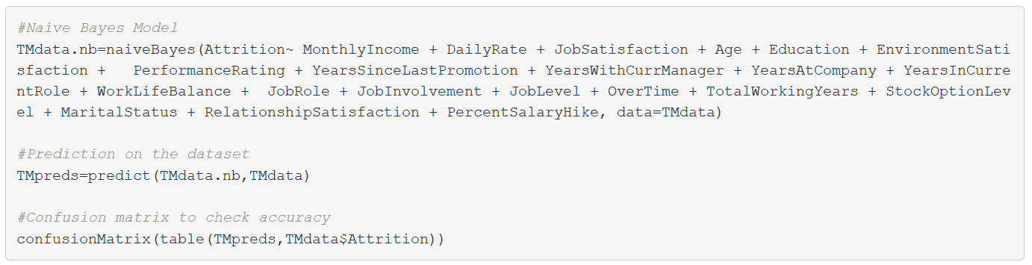
Naïve Bayes
Accuracy | 81.84%
Sensitivity | 85.48%
Specificity | 62.86%

Slide 12
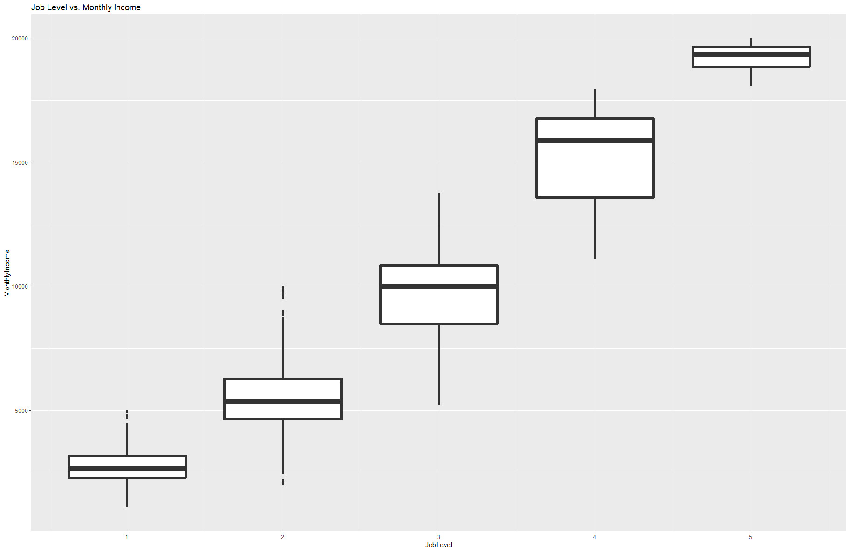

Slide 13
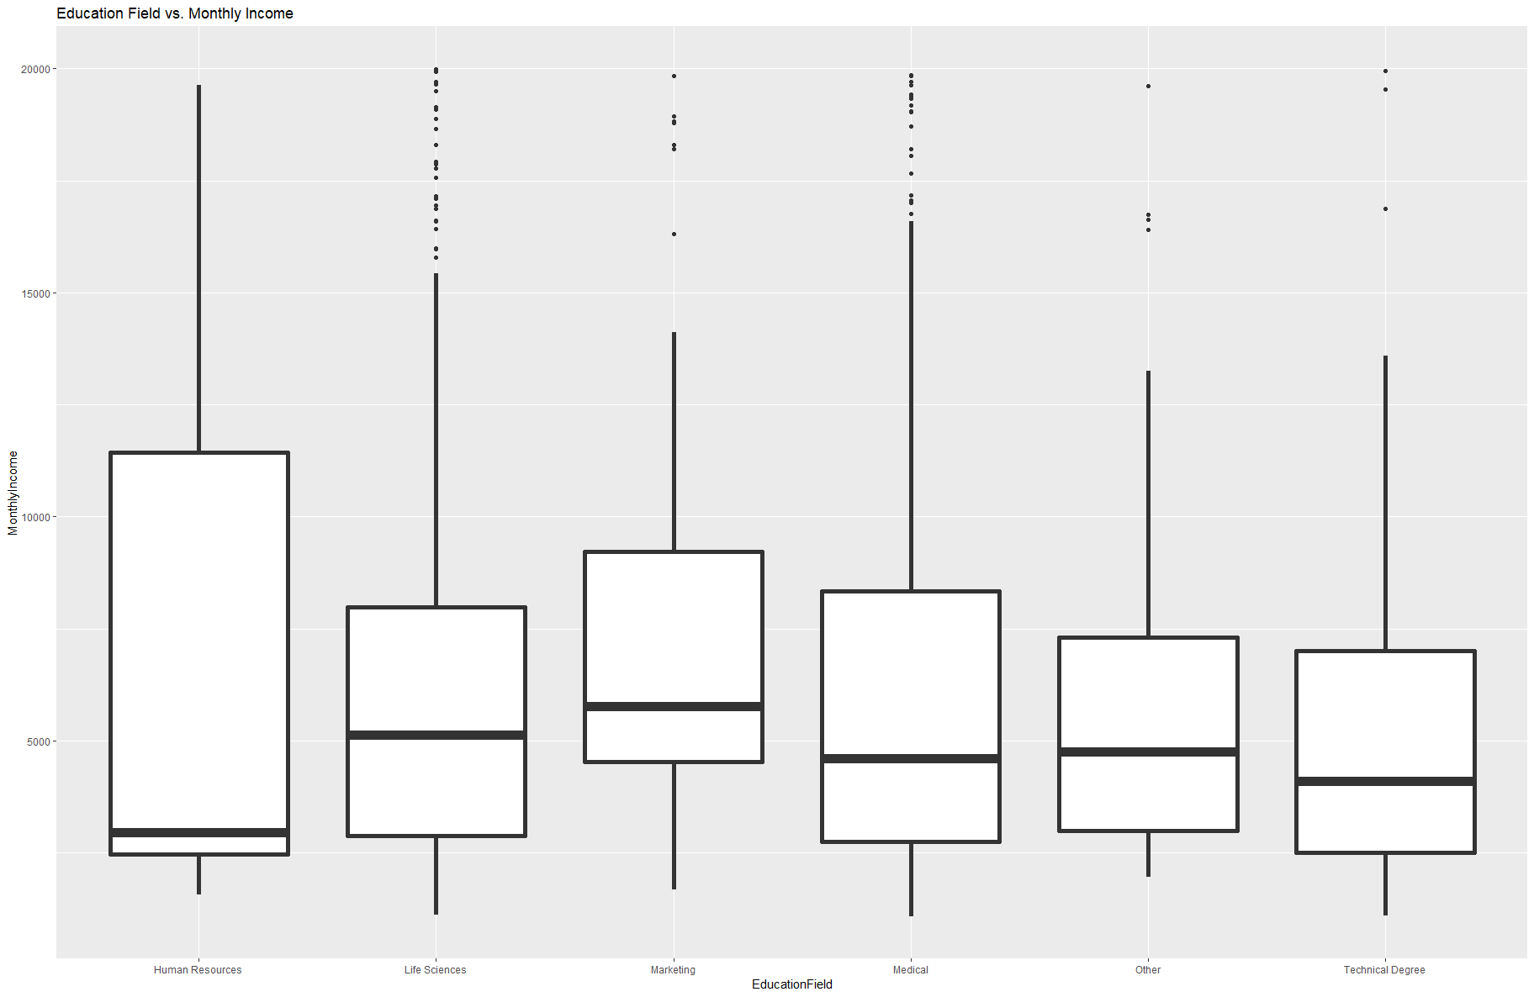

Slide 14
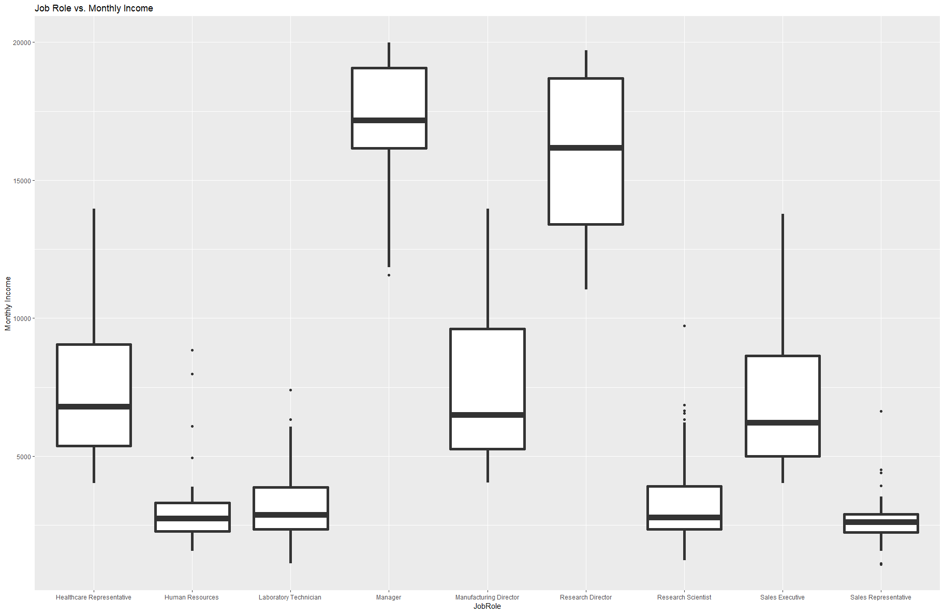

Slide 15
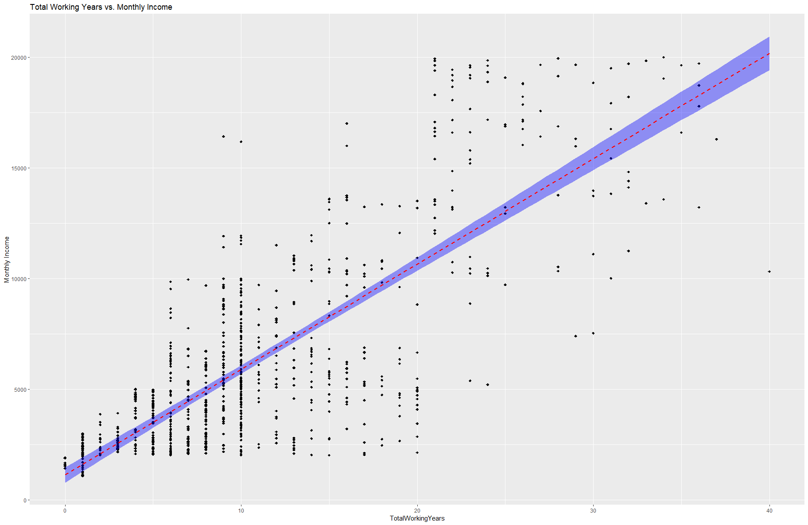

Slide 16
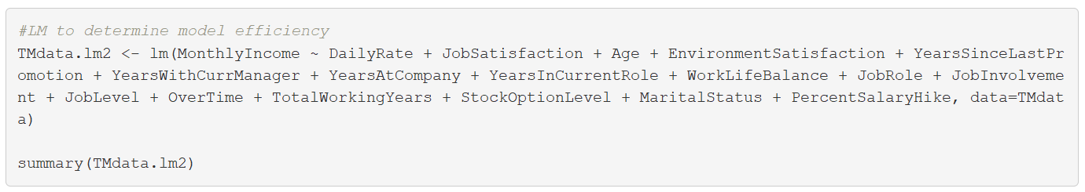
Monthly Salary Predictive Analysis
RMSE | 1048

Slide 17
Thank You

